Slide 1


SALES & PROFIT DASHBOARD
Designed by : Ganga GR
Tool : Microsoft Power BI
Dataset : Kaggle Sales Dataset

Slide 2

Objective
Provide interactive insights into company sales performance to support data-driven decisions.
KPIs:
Total Sales
Total Profit
Profit Margin
Total Quantity

Slide 3
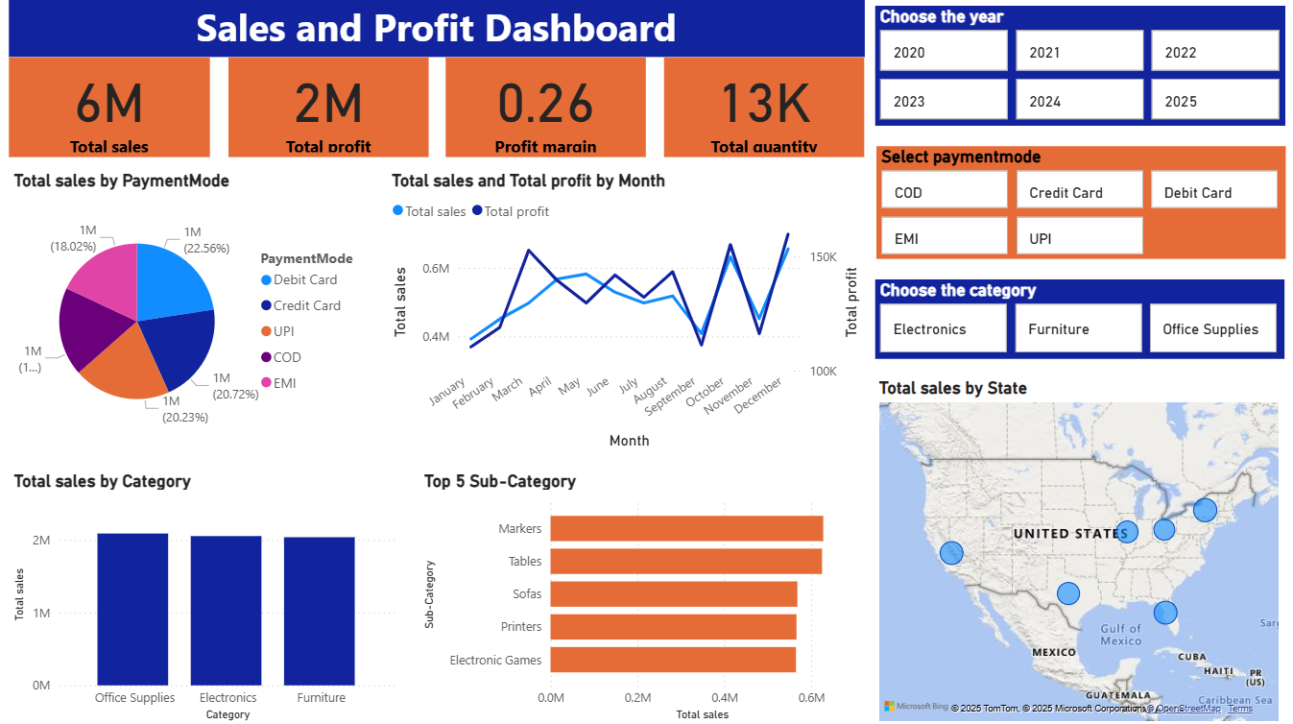
Dashboard Overview

Slide 4
Key Insights
Total Sales: 6M | Profit: 2M | Margin: 26% | Quantity: 13K
Highest sales in Office Supplies
Newyork → top state by sales
Debit Card is most used payment method and EMI is the less used.
May, October, December have highest sales where March, October, December have highest profit.

Slide 5
Business Recommendations
Boost Office Supplies: Focus marketing and offers on the top-selling category.
Target Key Regions: Strengthen stock and ads in high-sales states like New York.
Promote Digital Payments: Offer cashback for UPI/EMI to increase adoption.
Plan for Peak Months: Prepare inventory and campaigns for May, Oct, Dec.
Increase Profit Margins: Optimize costs and focus on high-margin products.
Retain Customers: Launch loyalty programs and personalized deals.

Slide 6
Thank you

